Slide 1
Wanting to bring the birds back?
Some things to consider before you start killing things.
A Nelson case study.
Notes:
This presentation shares some of the discussions we (DOC, NCC and community) are having as we start to develop the Nelson Halo project. They’re probably things that many of you are thinking about to, and if not, they should be, so we decided it was useful to share our thinking process so you could apply it to your projects.

Slide 2
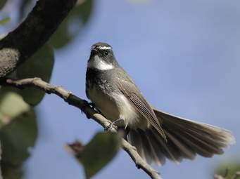
What do you want to achieve?
“Lets trap some pests – the native birds will thrive….”
Well, what is there already?
What do the bird species require?
How much effort is required to increase bird numbers?
What is the goal?
Do we have the resources and time?

Slide 3
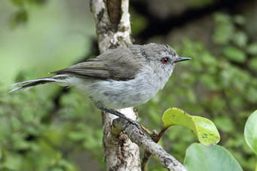
Which bird species would be present without any trapping?
Fantail
Grey warbler
Pied tit
Silvereye
- the little birds that breed fast,
nest in sites difficult for pests to access
Others
Weka – appear to be more resistant to mammalian predators
Kereru – long distance fliers – feeding here, nesting where?
Tui / bellbird – certain habitats, some resistance to rats
These species can already be seen in many forest patches in Nelson

Slide 4
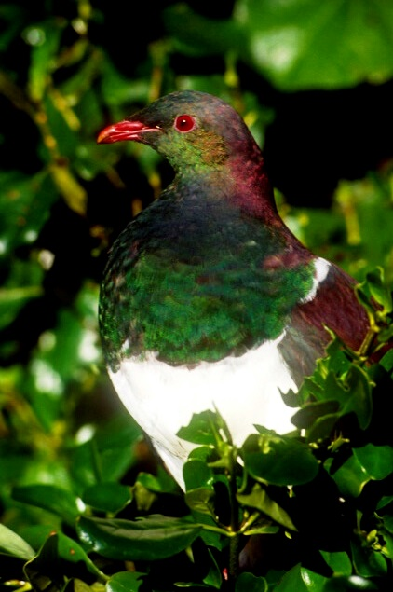
Native birds have differing habitat requirements
Due to:
Food: how they forage & what for
Nesting behaviour:
- Holes nesters
- Branch tips
- Canopy or sub-canopy
- Ground
Hence they have differing
vulnerabilities to introduced pests

Slide 5
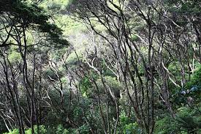
So what is trapping likely to achieve in your site?
Habitat? Is it:
Shrubland?
Previously milled native forest?
Pine forest?
Mature untouched native forest?
Each habitat will support a different suite of native birds

Slide 6
How much space do native bird populations require?
Self-sustaining population without need for re-introductions
Minimum Area required for Species Persistence (MASP):
area large enough to support native bird population with sufficient food & nesting sites and maintain genetic diversity (after Brown et al. 2015)
Native bird species: Common name | MASP (hectares)
Kererū, tomtit, silvereye, tūī, fantail | 1000
Robin, Nth Island kōkako | 2000
Kākāriki, mohua | 5000
Kākā, kiwi, kea | 10000
Whio | 30000
Notes:
Will send you some info Andrew dredged up re: kakariki area for translocation – are the figures here too high?
You probably need to briefly touch on why that’s impt (ie for genetic variability)

Slide 7
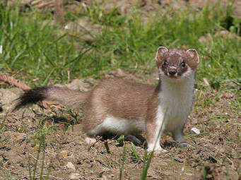
What is a low density for introduced predators?
Enough to detect an increase in bird abundance post-control?
How do you know what the predator abundance is?
Trapping returns don’t tell you what predators are left…..
Is monitoring in place?
Notes:
This is important
Just trapping pests is not enough if you are only getting half of them – the other half will thank you for getting rid of the competition
Independent monitoring will tell you whether you are actually doing the job you think you are

Slide 8
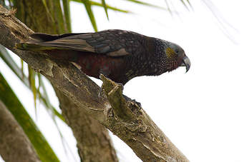
How do we bring all this together?
An example is the Nelson City ‘Halo’
Predator removal & habitat enhancement for native birds
Synergy with the Brook Waimarama Sanctuary –
similar to Zealandia in Wellington
How can we leverage off the BWS?
Enhancement of native bird numbers
in the city and beyond–
how do we go about it?
Notes:
Be good here to show a map of the Nelson area. Steve is preparing one, will send you the draft which he is modifying from my comments.
“We” as not just NCC, but also BWS + community

Slide 9
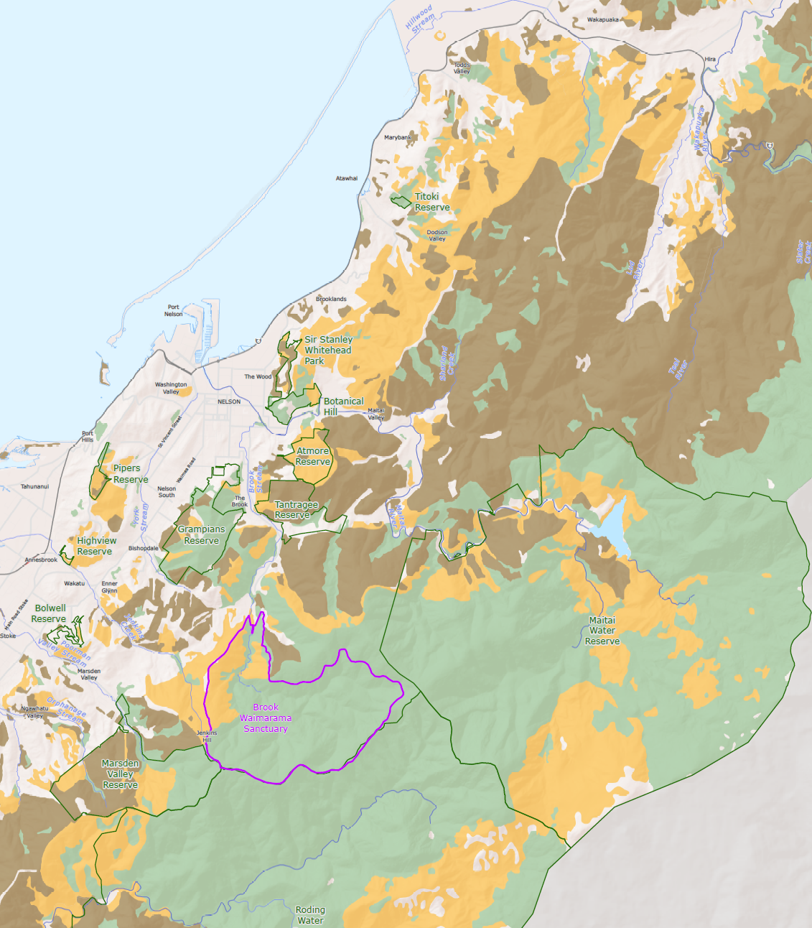

Slide 10
Lets enhance numbers of native birds in Nelson
O.K. – lets look at options
What species do we have at present?
Historically present – reintroduction to BWS?
What condition is the bird population in at present?
What does each species require to thrive?
- Habitat – nesting & feeding
- Food supply – seasonal requirements?
- Mammalian predator control
- Interactions with other bird species
Where do we need to do control/habitat enhancement?
Will they live in the city or fly from elsewhere for food/nesting?

Slide 11
Options for bird enhancement
Broad species requirements = representative species
General food requirements (overlap in most species):
Insectivores – pied tit, robin, fantail, grey warbler
Frugivores – kereru, kaka
Honey eaters – tui, bellbird
Mature forest dwellers, or more generalist in habitat requirements?

Slide 12
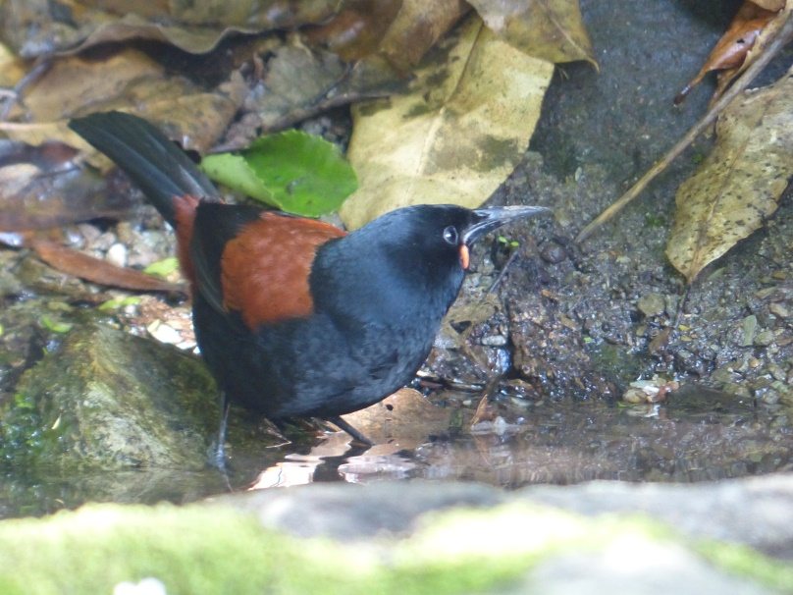
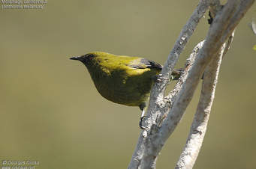
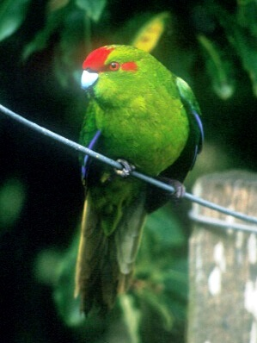
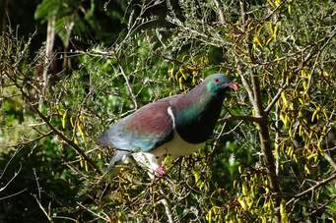
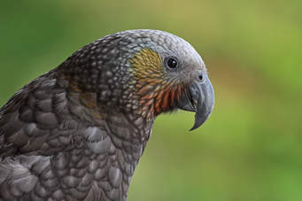
Representative bird species
for Nelson City
Tieke/ Sth Isld Saddleback
Bellbird / Korimako
Kereru
Kakariki
Kaka

Slide 13
Initial summary
Tieke/ Sth Isld Saddleback:
Small area required, insectivorous, shrubland/forest, hole-nester, highly vulnerable to all mammalian predators
Bellbird / Korimako
Small area required (?), honey-eater, shrubland/forest, tree-fork nester, vulnerable to some mammalian predators
Kereru
Large area required, fruit/leaf eater, forest/rural habitat, branch nester, vulnerable to several mammalian predators
Kakariki
Large area required, insect/fruit eater, mature forest, hole nester, vulnerable to several mammalian predators
Kaka
Large area required, insect/fruit eater, mature forest, hole nester, vulnerable to some mammalian predators

Slide 14
Conclusion
Tieke: do not pursue.
Probably only survive in predator-free environment (Brook Santuary)
Bellbird:
Likely to thrive with suitable predator control,
improved habitat & food supply
Kakariki:
Likely to thrive with suitable predator control & large area of forest
Unlikely to nest in city
Kereru
Likely to thrive with suitable predator control & large area of forest
Tree planting to bring into city?
Kaka
Likely to thrive with suitable predator control & large area of forest
Tree planting to bring into city? Unlikely to nest in city.

Slide 15
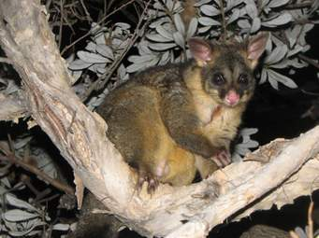
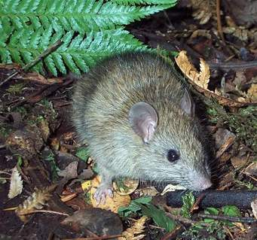
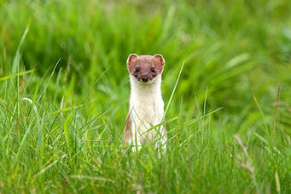
What level of pest control required?
Which predator and to what level?
To reduce mammalian predator numbers
- to allow selected native bird species to increase
Rats: <5% tracking, particularly during spring
Possums: <10% RTC
Stoats: <5% tracking
Notes:
Tracking involves setting out lines of tunnels, then recording the number of tunnels that record animal tracks across the baited cardboard tracking cards placed in them. Do it once every 3 months.
RTC is a TLA for Residual Trap Catch – setting out lines of possum leg-hold traps and recording the number caught. Other methods, which involve less work, include using lines of baited chew cards and recording how many cards possums have chewed. Every 3 months again.
There are several websites that discuss the techniques, how to run them and how to interpret the results.

Slide 16
Bringing it all together:
For selected bird species to increase in numbers in Nelson
Bellbird: Maintain ship rat & stoat numbers <5% tracking
over 500ha+ forest/shrubland
(about the size of BW Sanctuary)
Kereru: Keep ship rats <5% tracking/possums <10% RTC
over 1000ha+ forest/rural area
(BWS + Upper Roding catchment)
Kakariki: Maintain ship rat & stoat numbers <5% tracking
over 5000ha+ forest/shrubland
(BWS & upper Roding & Maitai)
Kaka: Keep stoats <5% tracking / possums <10% RTC
over 10,000 ha mature forest (~ 10% of Richmond Ranges)
Notes:
Need a map to accompany this so people have a context of area. Can re use the map from earlier.

Slide 18
Now lets see what is feasible:
Consider:
- Locations? Only current sites trapped by locals?
additional sites – Roding catchment?
Other sites?
- Resources? More traps – numbers and type?
Tracks for servicing?
- Monitoring? Pest abundance, bird numbers in response?
Is the work producing results??
- Staffing? Paid personnel & volunteers?
- Cost???
- Issues? Poison use, non-target by-catch, domestic pet predation…
Notes:
Be good to mention: where to from here?
Part of the genesis of the workshop was to bring the Nelson groups and individuals together to discuss these issues. However, we’re bigger than Nelson here, so we’re going to park that discussion until when we break into our regional groups later today.
But we thought the process we were going through with the Nelson Halo would be useful to other sites.

Slide 19
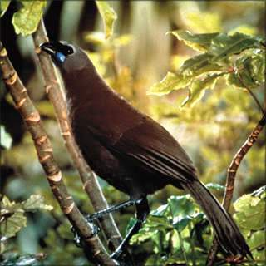
Summary
Start with where you want to go!
- Figure out which species you would
like to see in your site
- What is needed for them to thrive?
- Do we have the resources to get there?
- How do we know predator numbers are low enough?
- Are we making a difference?
- Let people know your successes (& failures – its how we learn!)
Good luck!
Notes:
To get to a destination you need to know where you are going – what do we want to be at the destination?
Get a map and a way of getting there.
Understand the ecology of the species
How much is going to cost? Can we get help? How much time can we afford? Work it out then re-assess.
Simply recording numbers of pests trapped isn’t enough, you need to know how many are left. They are the important ones….
Are your bird numbers going up? Really?
Advertising pays! Talk to others and learn from them.

