Slide 1
Using Biology to Enhance Pest Control
Understanding your pests
Notes:
Thanks for the intro.
This is a quick look at some pest animals and how we might use this to make our pest control more effective.
It is by all means not a complete list but a bit of a taster as I could probably spend 30mins on each pest.
If you want more information then I would recommend reading this book, Handbook of NZ mammals.
So a quick overview….

Slide 2
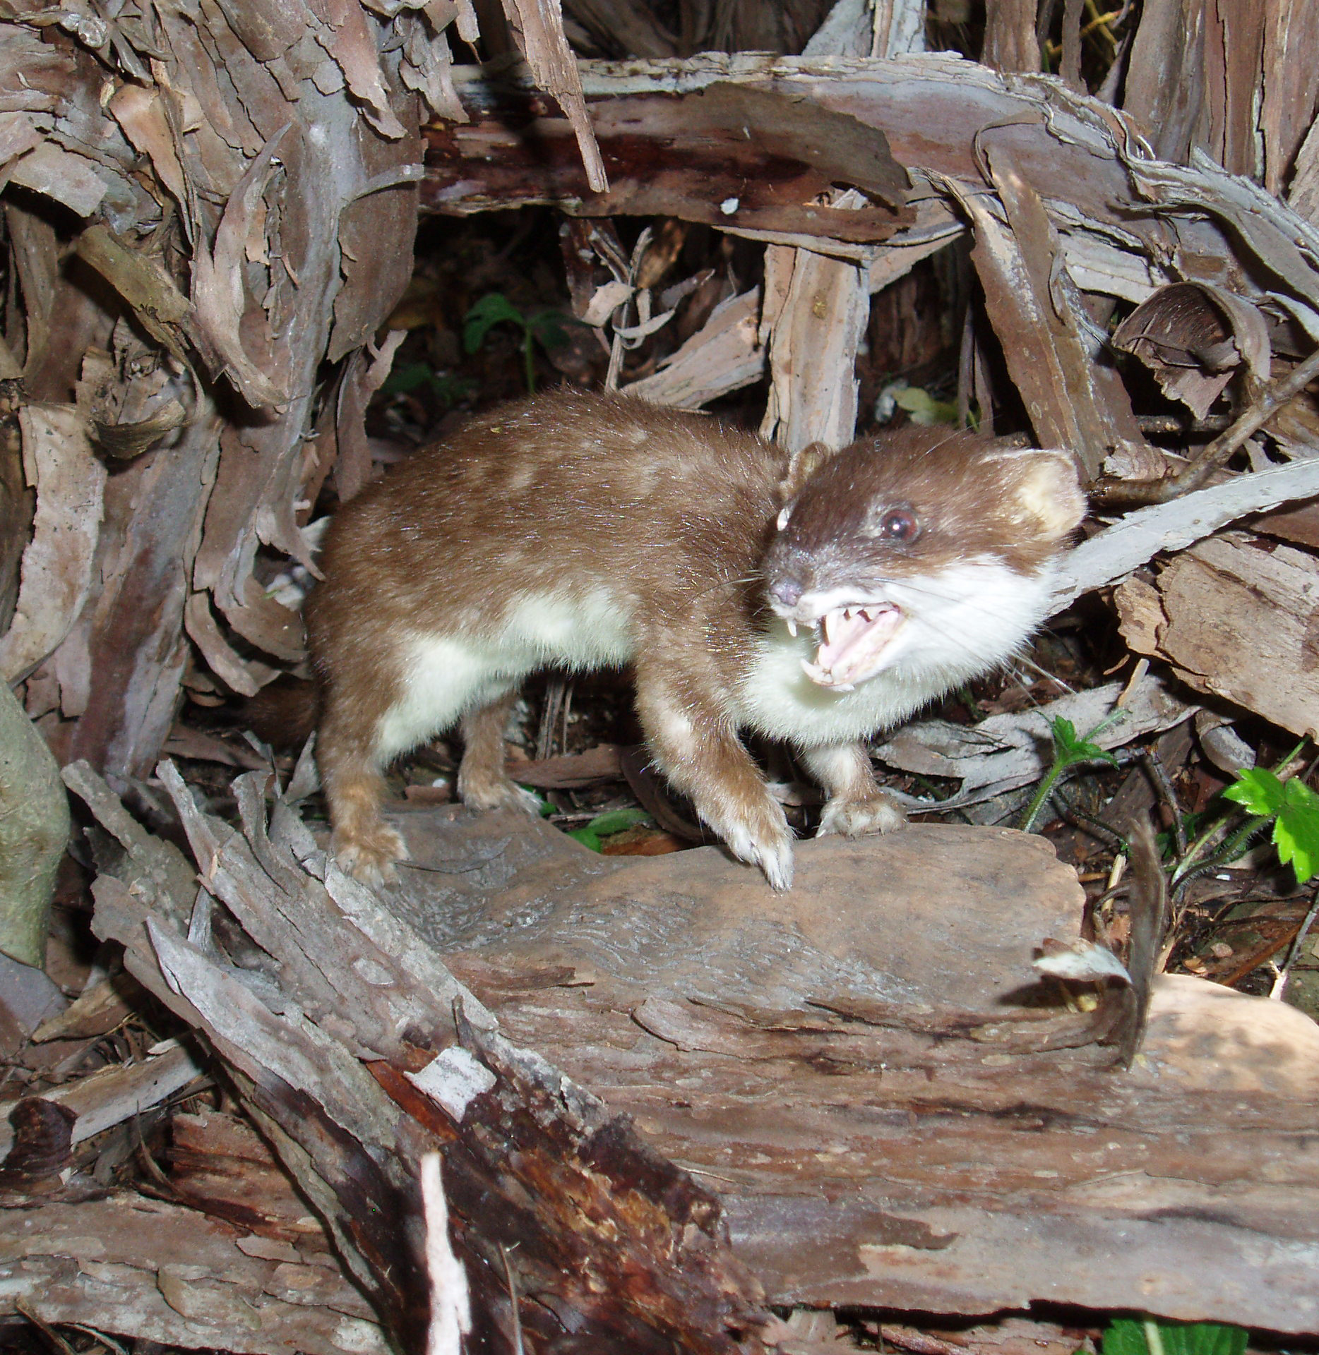
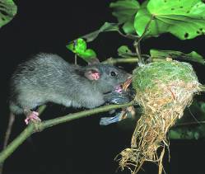
Overview
Lifespan
Home range
Habitat
Breeding
Behaviours
Food
Control considerations
What does their poop smell and taste like
Notes:
2
We’re going to look at
How long they live for.
How far they move around.
Preferred habitat.
Breeding, how many offspring etc
Behaviours.
What do they eat.
How to use this info for your control.
And not this….
Ok we’ll start with our old mates from across the ditch … possums

Slide 3
Possums
Notes:
Introduced for the fur trade
With the first successful introduction was down south in 1858.
Ironically where it failed 20 years before.
All up around 200 – 300 individuals were imported.
Just over half of them came from Tasmania.
Protected from 1913 to 1946.
Not much difference in size between adult males and females, with males slightly bigger weighing over 6kg.

Slide 4
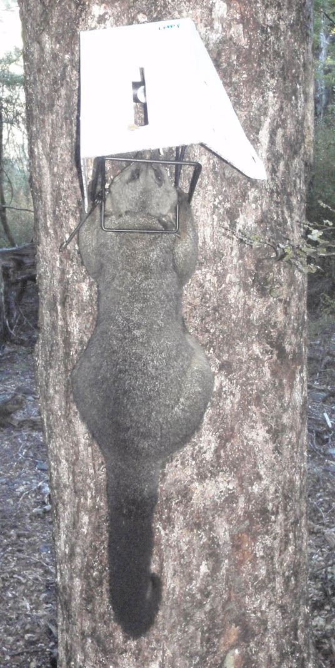
Possums
Lifespan: 14 years
Home range size: 24.6ha
Habitat: Sea level to alpine zone!!
Breeding: Can have 2 young per year
Behaviours: Nocturnal, hierarchical
Food: Opportunistic herbivore
Control Considerations:
Visual lures
Different lures
100m x 100m
Notes:
Lifespan:
Females live slightly longer than males.
Home range size:
Home ranges overlap with males having larger ranges
Can be quite large and in open country can range over 1.6km.
Habitat:
Wide range of habitats, except high rainfall, mountains in southwest Fiordland.
Up to 2400m, often foraging above the snow line in beech forest.
Also found in urban areas.
Breeding:
Males mature at 1 to 2 years old, females have been known to breed as 1 year olds.
Births are recorded in every month of the year but the main birth season is autumn.
If in good condition can produce 2 young per year.
Young become more independent around 250 days with females generally establishing a home range close to the mothers.
Males gradually shift away over the first 2 to 3 years and settle several range lengths away.
Behaviours:
Nocturnal.
Generally avoid each other except during breeding season or female with young.
Although if there is limited den sites then may share
Larger older animals dominate smaller younger ones.
Poor sense of smell but visually attracted to bright things
Food:
Favorite food trees
Known to predate eggs and chicks.
They have been filmed killing and eating a kea juvenile.
Will scavenge carcasses.
Control Considerations:
Mostly have bright white covers to attract animal from a distance
Spacing between traps important. So there is at least one trap in it’s territory.
Trapping can be successful with lower possum densities.

Slide 5
Stoats
Notes:
Introduced in 1884 to control rabbits.
Probably from Britain.
Legally protected till 1936.
Size: Female smaller around 207g, males around 324g.
Very fast heart rate of 400 to 500 beats per min.
Good climber with sharp claws and light weight.
Swims up to 1500m.
Active day and night with eyes capable of night vision.
Will turn white in winter in colder areas.

Slide 6
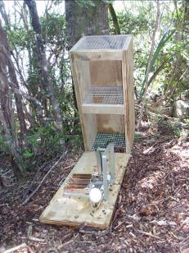
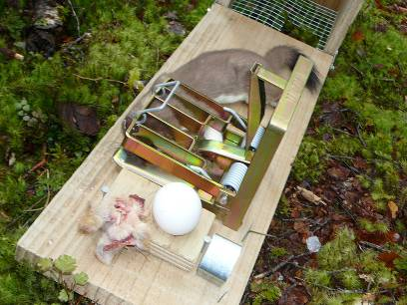
Stoats
Lifespan: 5 years
Home range size: 220ha
Habitat: Sea level to alpine zone!!
Breeding: Can have one litter of 13 per year.
Behaviours: Active day and night
Food: Carnivore
Control Considerations:
Tunnels
Bush edge/fence lines
100m x 1km
Notes:
Lifespan:
Most live under 2 years but can live over 5 years.
Home range size:
Female range smaller 94ha.
Overlap between sexes.
Depends on food availability, can be ½ the size if plenty of food.
Habitat:
Wide range of habitats, not affected by high rainfall, more common in forest.
Also found in urban areas, farmland.
Breeding:
Males mature at 10 months old.
Males search for breeding females in dens from Sept to Nov.
Male will mate with breeding female and any young females in the den (may only be a few weeks old).
Females can delay implantation till the next spring.
The number of young is determined by the amount of food available and young are born 4 weeks after.
The timing of the breeding season is controlled by day length.
Juveniles become independent at around 12 to 14 weeks old.
Can disperse large distances quickly, female caught and tagged at Eglington Valley on 20th Dec was caught 24 days later in trap 65km at Burwood Bush.
Behaviours:
Will stay under cover during daylight.
Use the burrows of other animals as dens.
Generally on their own, but are seen as family groups of adult female and her young
Have been know to kill all the chicks in a nest, but also to ‘Farm’ nests.
Food:
Rodents, rabbits, hares, birds/chicks and eggs.
Also insects and known to scavenge carcasses.
Can kill prey larger than themselves.
Will kill everything in a nest and eat what it can and cache the rest.
Need to feed 5 to 6 times per day.
Male eats around 90g per day.
Research in Fiordland beech forest showed that birds were still the most common prey even when mice were abundant (due to more stoats).
Control Considerations:
Individual stoats can become wary of traps.
Trap placement important.
Varity of baits.

Slide 7
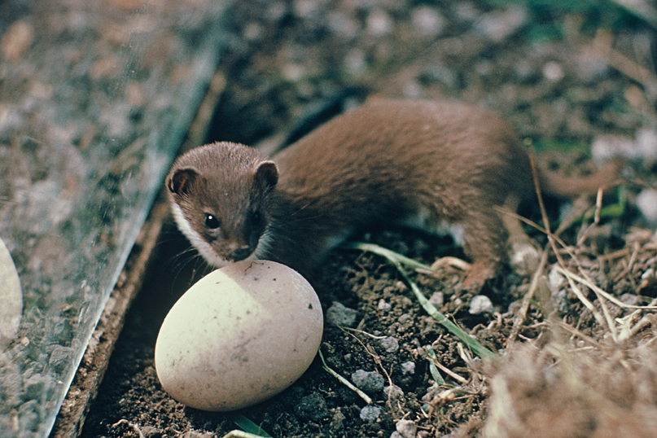
Weasels
Notes:
Introduced in 1800s for the same reason as stoats to control rabbits.
Although more weasels were released have been out competed by stoats.
Size: Female smaller around 67g, males around 185g.
Also good climber with sharp claws and light weight.
Swims possibly up to 900m.
Active day and night.
Due to their size they can get into smaller holes after prey.

Slide 8
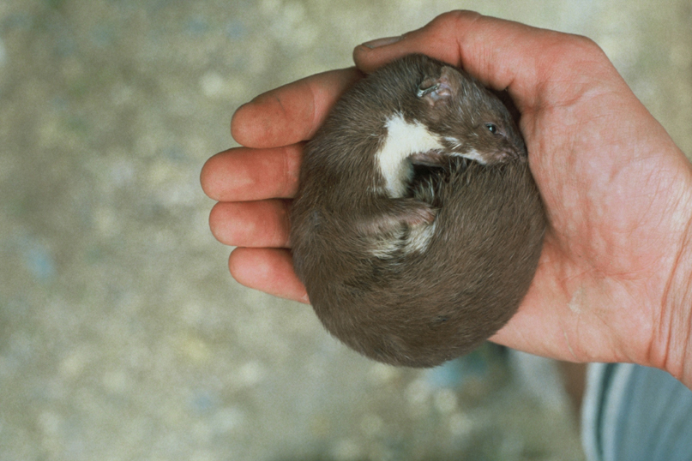
Weasels
Lifespan: 2 years?
Home range size: 25ha?
Habitat: Anywhere with mice and thick ground cover
Breeding: Could have more than one litter per year
Behaviours: Active day and night
Food: Small prey
Control Considerations:
Tunnels
Bush edges/fence lines
100m x 1km
Notes:
Lifespan:
Probably only 2 years.
Home range size:
Female range only 10ha.
After vole population crash in Poland males had range up to 216ha.
Less food the larger the home range size.
Habitat:
Prefer thick ground cover. More common in bush margins and areas where mice are more abundant.
Includes suburban areas, farmland.
Breeding:
Breeding season Sept to March.
Different to stoats. Cannot delay implantation.
Could have up to 3 litters per year, but seldom do in the wild.
Normal litter size probably 3 to 4, but could have up to 8.
Juveniles become independent at around 12 weeks old.
Both male and female can breed in the year of their birth if there is plenty of food.
Behaviours:
Will stay under cover during daylight.
Like stoats will kill everything in a nest and eat what it can and cache the rest.
Generally on their own, but are seen as family groups of adult female and her young
Food:
Small prey, mice, birds/chicks, insects, lizards and eggs.
Good at getting into holes.
Also small rabbits and are known to scavenge carcasses.
Need to eat about a 1/3 of body weight per day.
Control Considerations:
Similar to stoats… often caught as by-catch in stoat traps.
Predated by stoats, cats and ferrets.
Often caught when stoat numbers are low.
Individuals can become wary of traps.

Slide 9
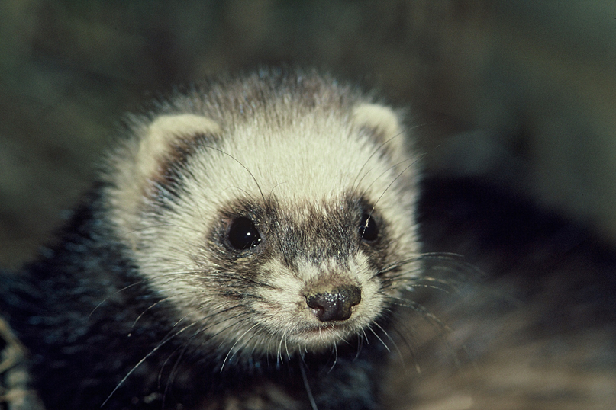
Ferrets
Notes:
Introduced in 1800s for the same reason as stoats to control rabbits.
Thousands introduced from Australia and Britain, also thousands bred locally.
Size: Female smaller around 1kg, males around 1.9kg.
Poor climber.
They can swim rivers, but no records to offshore islands.
Poor day time eyesight and are mostly active at night, any day time activity usually underground.
Can carry TB

Slide 10
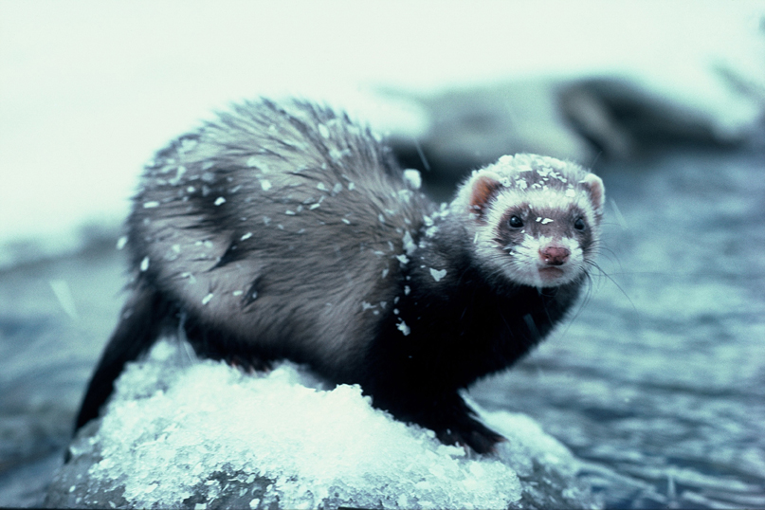
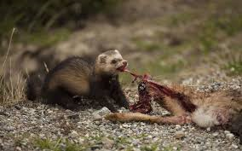
Ferrets
Lifespan: 8 years?
Home range size: 760ha
Habitat: Most common in pastoral areas
Breeding: Can have a litter of 12
Behaviours: Mostly nocturnal
Food: Small mammals and birds
Control Considerations:
Trap need larger entrance
Notes:
Lifespan:
Can live to 13 years in captivity.
Home range size:
Range size depends on food supply, so can be quite small (16ha – female)
Over all female range is smaller.
Habitat:
Forest margins, anywhere there is lots of rabbits.
Riverbeds but will seldom move into open river gravel while hunting.
Breeding:
Cannot delay implantation.
Breeding season starts in September, first litter born in Oct to Nov.
Could have up 2 litters per year, but rare in the wild.
Normal litter size probably 4 to 8.
Juveniles become independent at around 3 months old.
Can disperse to over 45km away.
Female can breed in the year of their birth if there is plenty of food.
Behaviours:
Eyesite poor during daylight.
Generally on their own, but are sometimes seen as family groups
Food:
Most common prey is rabbits.
Will prey on ground nesting birds such as penguins.
Usually hunt rabbits underground.
Known to scavenge carcasses.
Control Considerations:
Similar to stoats… often caught as by-catch in stoat traps.
Need larger size trap.
Individuals can become wary of traps.

Slide 11
Rats (Ship)
Notes:
Ship rat arrived here after the Norway rat.
Most common rat found in beech forest.
First here accidently 1800s, didn’t really spread till late 1800s.
Male can weigh up to 290g.
Good climber.
Can swim up to 750m.
Nocturnal.
Excellent sense of smell and hearing.

Slide 12
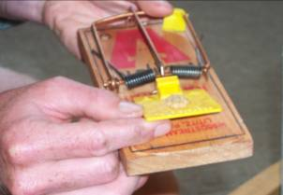
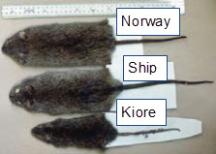
Rats (Ship)
Lifespan: 18 months
Home range size: 700m
Habitat: All habitats below the treeline
Breeding: Up to 8 per litter
Behaviours: Nocturnal
Food: Omnivorous
Control Considerations:
Small home range
Can reach high numbers
Notes:
12
Lifespan:
Probably less than 2 years old in the wild can live to 3.5 years in captivity.
Home range size:
Males rats in the Eglington moved up 700m in a night.
Females only 100m.
Home range is 3-dimensional.
Habitat:
Sea level to the treeline.
More common in lower altitudes.
Breeding:
One female probably produces about 16 young.
Litters average about 5.3 young.
Interval 32 days between litters.
Wean at 28 days.
Mature at 3-4 months.
Behaviours:
Nocturnal
They will cover most of their home range in a night
Cautious of new things
Food:
Omnivore, have been known to kill small birds on nests.
Prey on insects, lizards.
Control Considerations:
Traps need to be close together
It may take some time for them to overcome caution around trap
Trapping – only effective if rat numbers low.

Slide 13
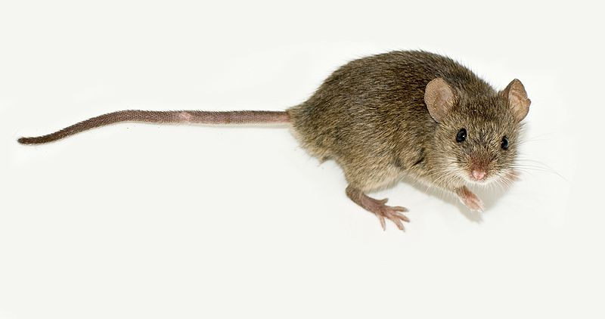
Mice
Notes:
First recorded in NZ on Ruapuke island after a shipwreck in 1824.
Not found in the South Island till the mid 1850s.
Weigh around 20 to 25g.
Good climber.
Can swim rivers etc.
Mostly nocturnal.
Excellent sense of smell and hearing.

Slide 14
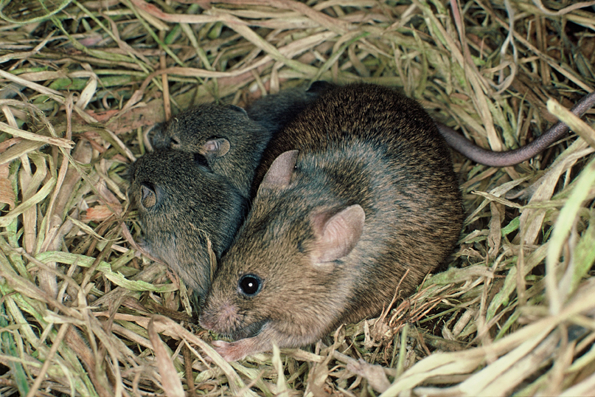
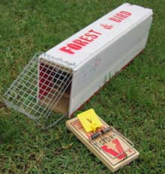
Mice
Lifespan: 18 months
Home range size: 58m
Habitat: All habitats including subalpine tussock
Breeding: Up to 9 per litter
Behaviours: Mostly nocturnal
Food: Omnivorous
Control Considerations:
Trapping very difficult
Notes:
14
Lifespan:
Can live to over 3 years in captivity, most less than 1 year.
Home range size:
One recorded as covering 2.62ha in 3 nights.
Density can reach up to 39 per ha.
Habitat:
Population fluctuates with food supply.
Like dense ground cover.
Also found in houses etc.
Breeding:
Breeding normally ceases in winter except when large food supply, heavy beech seeding etc.
Mature at 8 weeks old.
Pregnancy 20 days.
Litters average about 6 young.
Interval 32 days between litters.
Wean at 23 days, then leave the nest.
One female can produces numerous young.
Behaviours:
Nocturnal
Can reach high numbers in a small area
Food:
Extremely flexible in diet.
Lots of seeds.
Omnivore, have been known to kill small birds (Rock Wren) on nests and lizards.
Eat lots of insects, spiders, caterpillars etc.
Energy demands equivalent to 738 mountain beech seeds per day (if only food available).
Control Methods:
Trapping – only effective if numbers low, traps have to be very close together (25m grid).

Slide 15
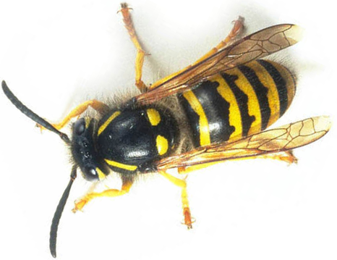
Wasps
Notes:
Common and German wasps.
German wasps arrived late 1940s and commons in the 1970s.
Nest can over 10000 workers wasps.

Slide 16
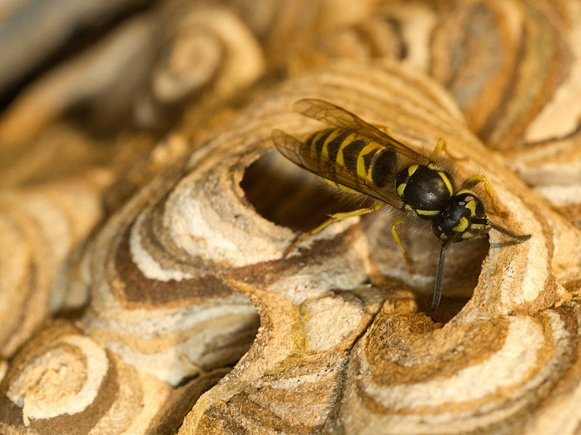
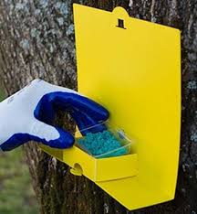
Wasps
Lifespan: Workers 2 to 3 weeks, Queens one year
Home range size: Can range for several hundred metres
Habitat: All habitats below around 1000m
Breeding: Annual cycle
Behaviours: Social insect
Food: Workers need carbohydrates
Developing Larvae need protein
Control Considerations:
50m x 300m lines
Only last one season
Notes:
16
Lifespan:
Workers don’t live for long, the queen in the nest will live for that season.
Home range size:
German wasps in urban areas over 1km
Habitat:
Common wasps dominate honey dew beech forest, German wasps more likely in urban and farmland.
Breeding:
Queens overwinter, starts building the nest in spring, eventually enough workers hatch to continue
Late summer lays queen and drone eggs they hatch and mate the rest of the nest dies early winter new queens overwinter.
Behaviours:
Aggressive when nest disturbed.
Food:
Honeydew, willow aphid….invertebrates, carrion.
Control Methods:
Line spacing important
Queens re-infect from outside control area.

